Slide 1



Prof. V. B. Shah Institute of Management, R. V. Patel College of Com. (Eng. Med.), Sutex Bank College of Computer Applications & Science (Eng. Med.), V. L. Shah College of Com. (Guj. Med.), Amroli
GUIDED BY:
PROF. Ashish Solanki
NAME | ROLL NO | UNI_SEAT_NO
CHODAVADIYA TIYANSI | 530
KOLADIYA JENSI | 534

Slide 2

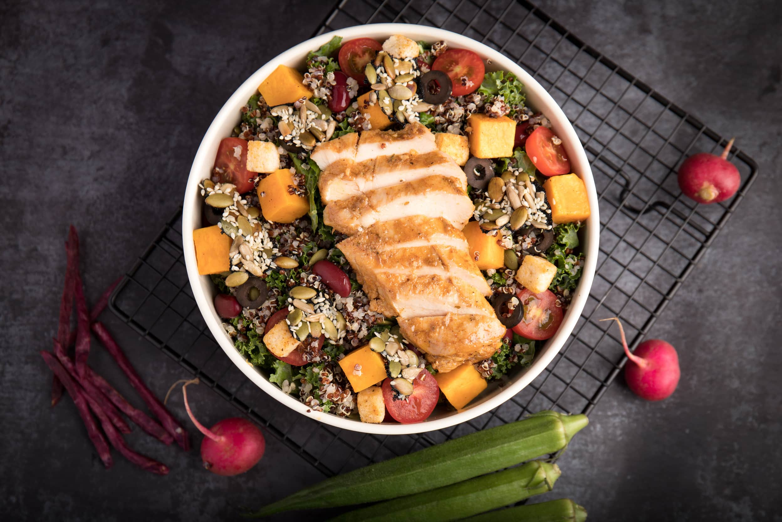
Grand
Restaurant

Slide 3
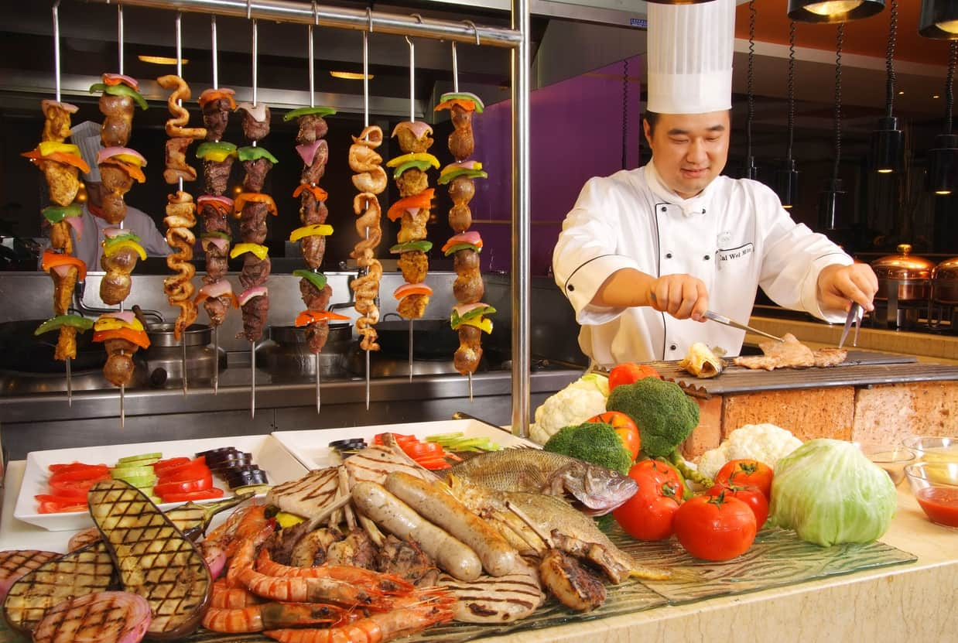
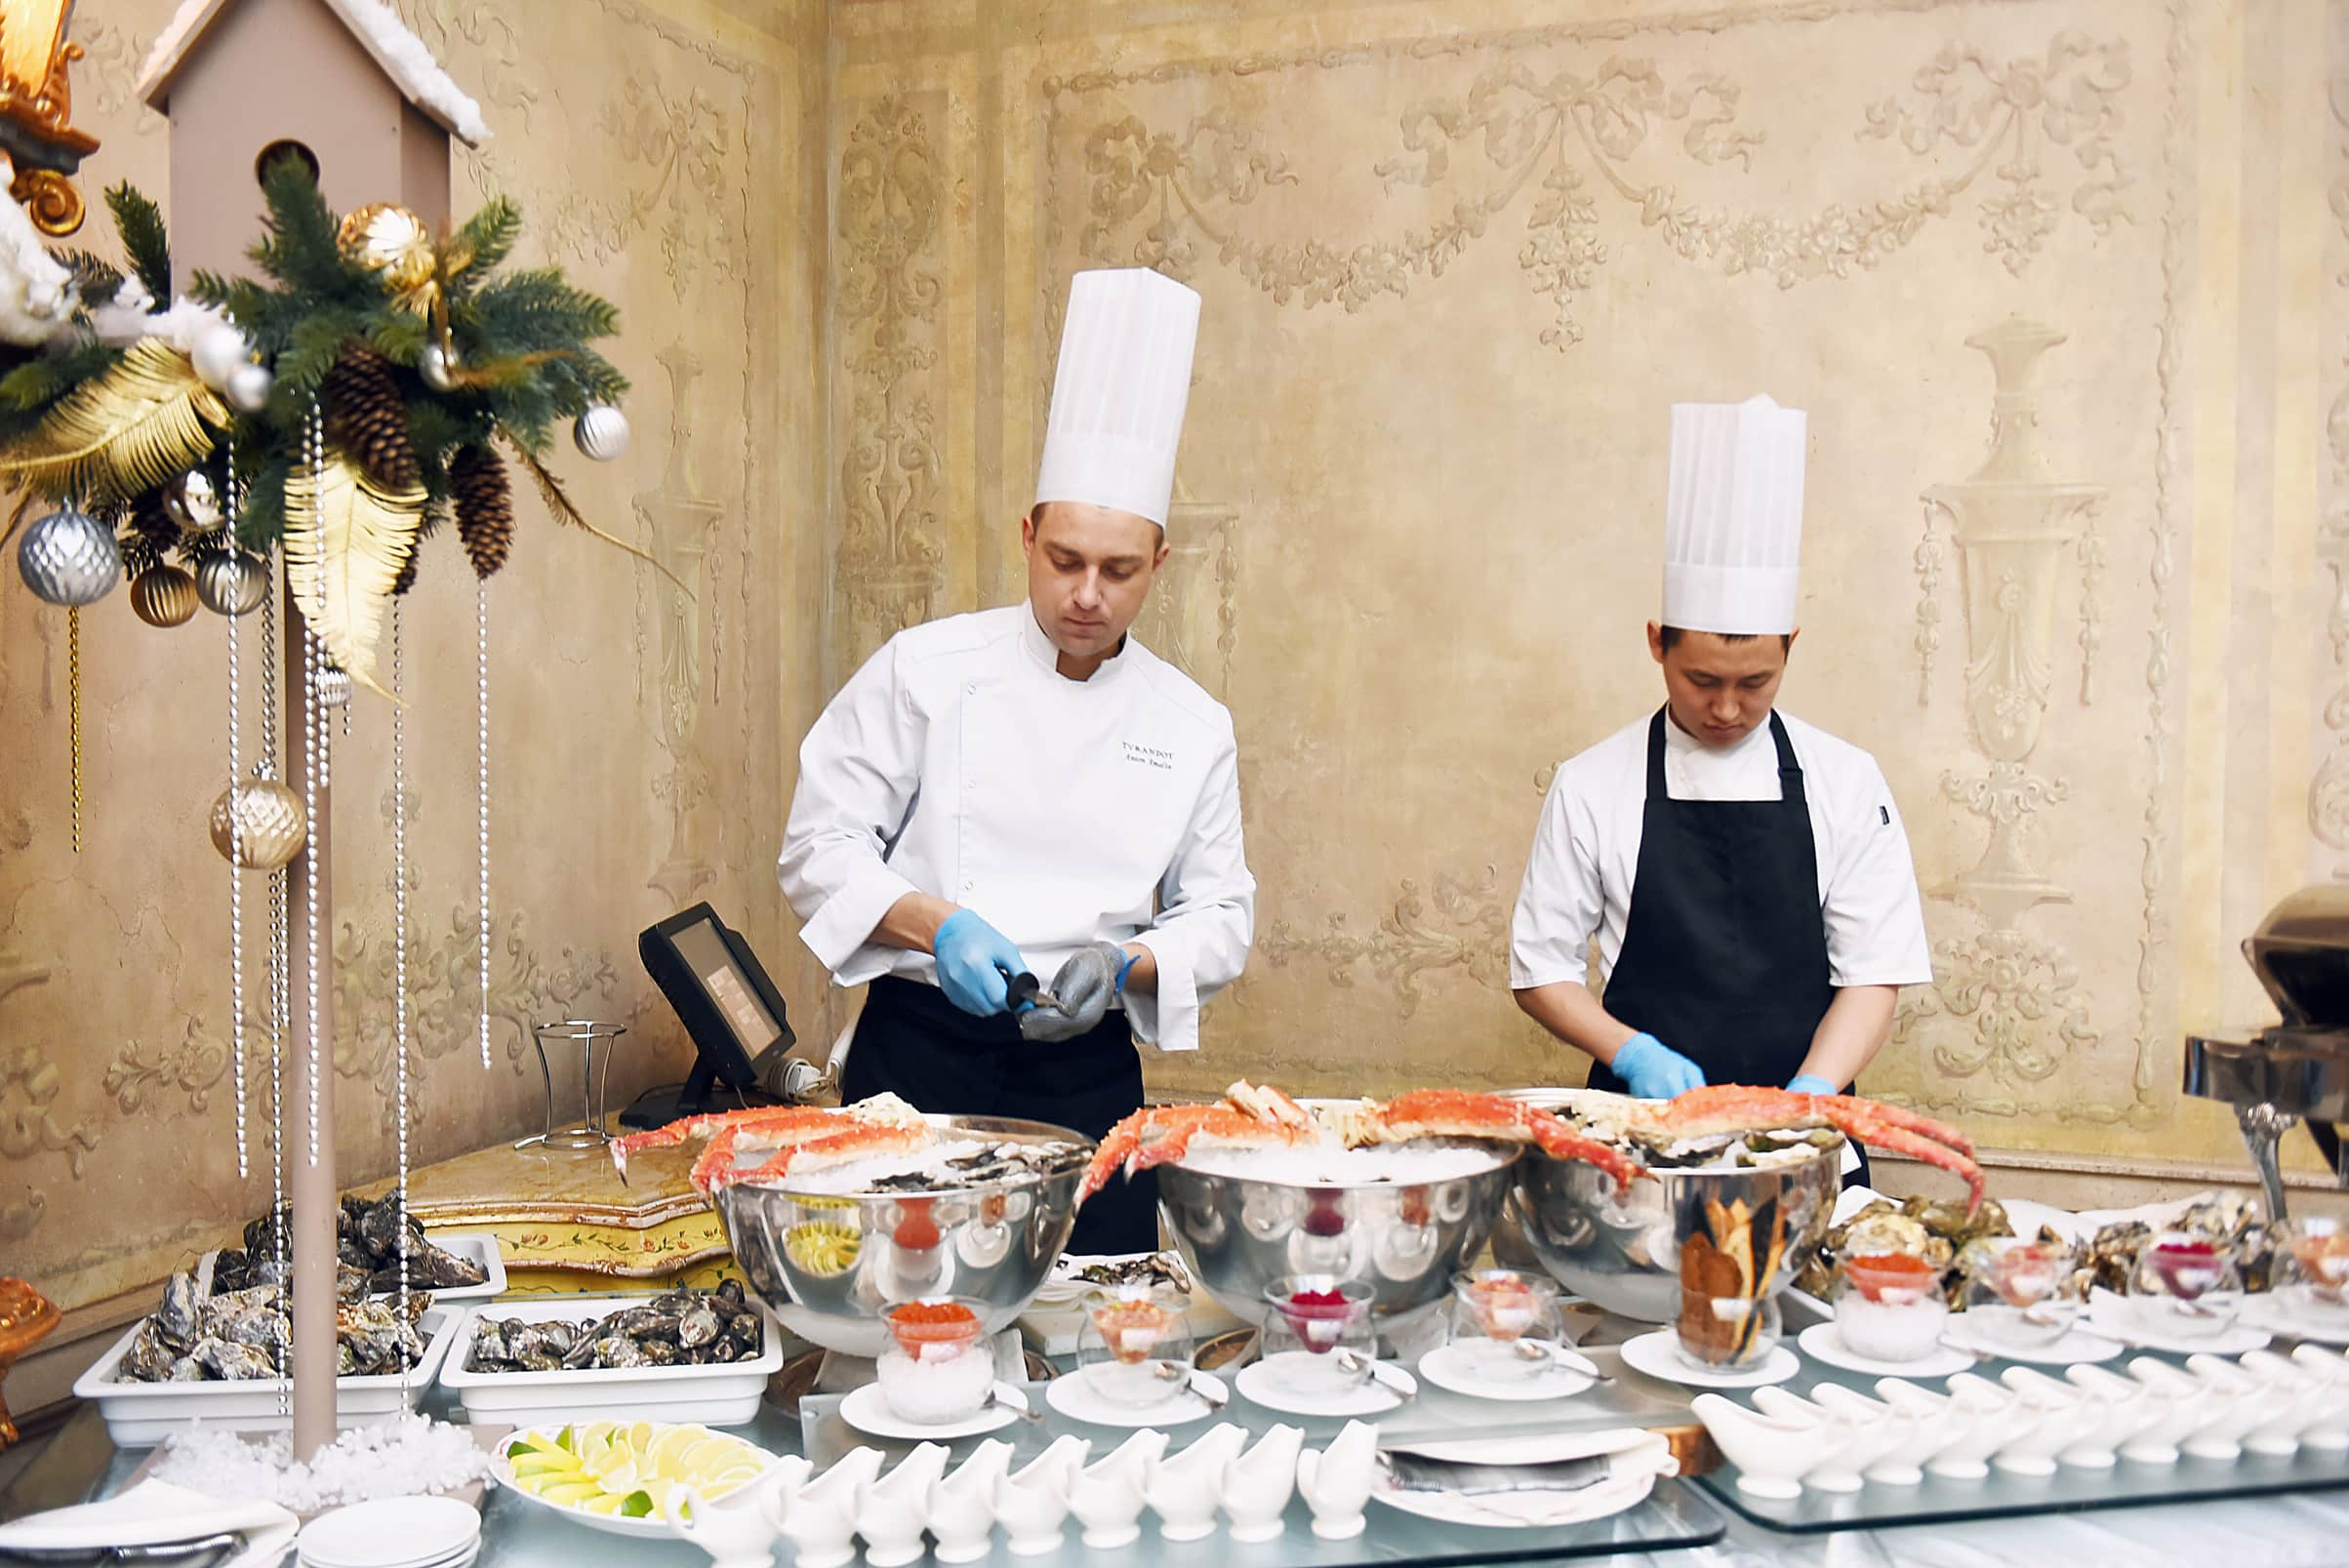
Grand restaurant
Agenda :-
Introduction
Hardware / Software Requirements
Features
Goal
Flowchart

Slide 4

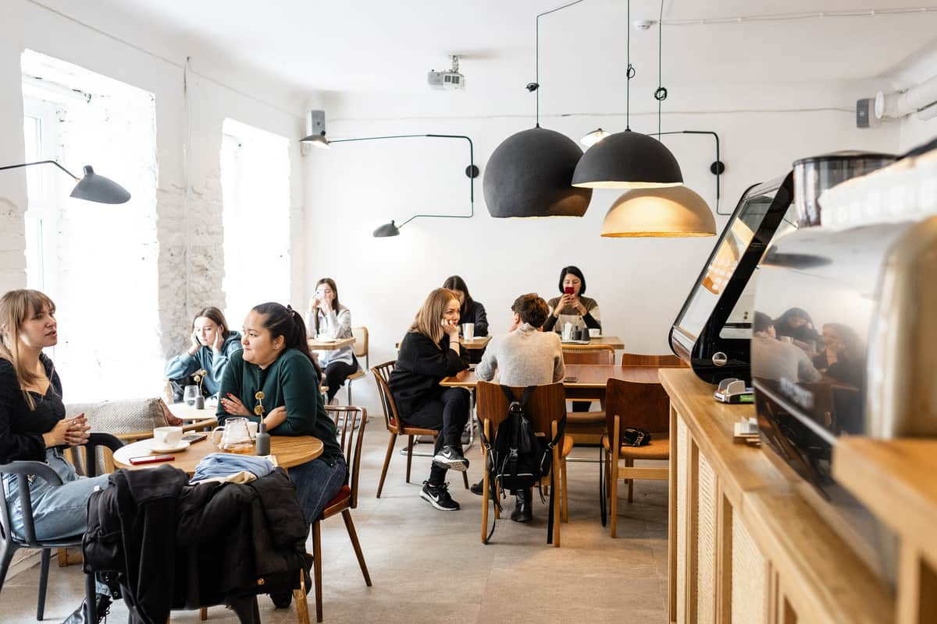
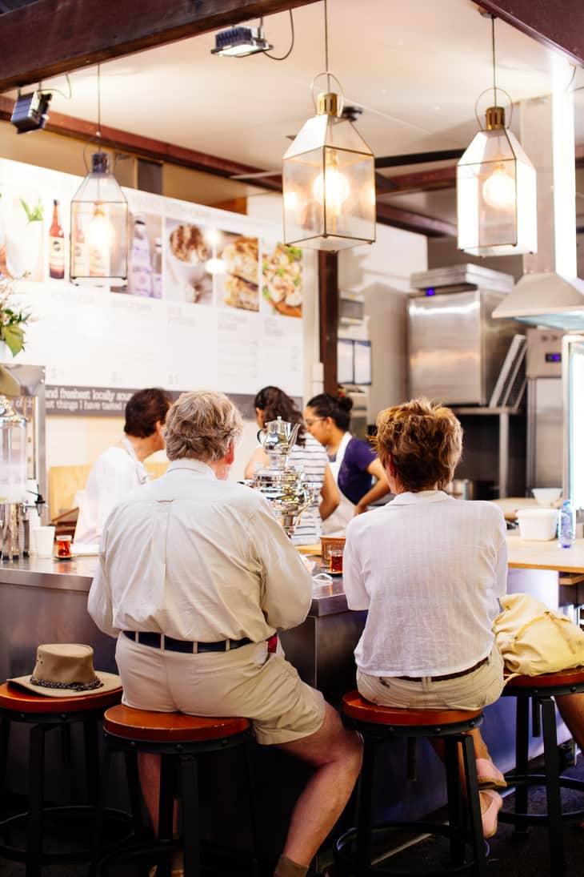
Grand restaurant
Introduction
Various Types of Food
In today’s fast-paced world, classic cravings website have revolutionized the way people order and enjoy their meals. This platform provide a convenient way for customers to browse menus, place orders, and have food delivered straight to their doorstep.

Slide 5
Grand restaurant
HARDWARE REQUIREMENTS :-
● Processor: i5 8th gen
● Ram: 16gb
● Hard disk: 512gb
● Moniter: 15th color moniter
SOFTWARE REQUIREMENTS :-
● Order management
● Delivery management
● Content management system

Slide 6
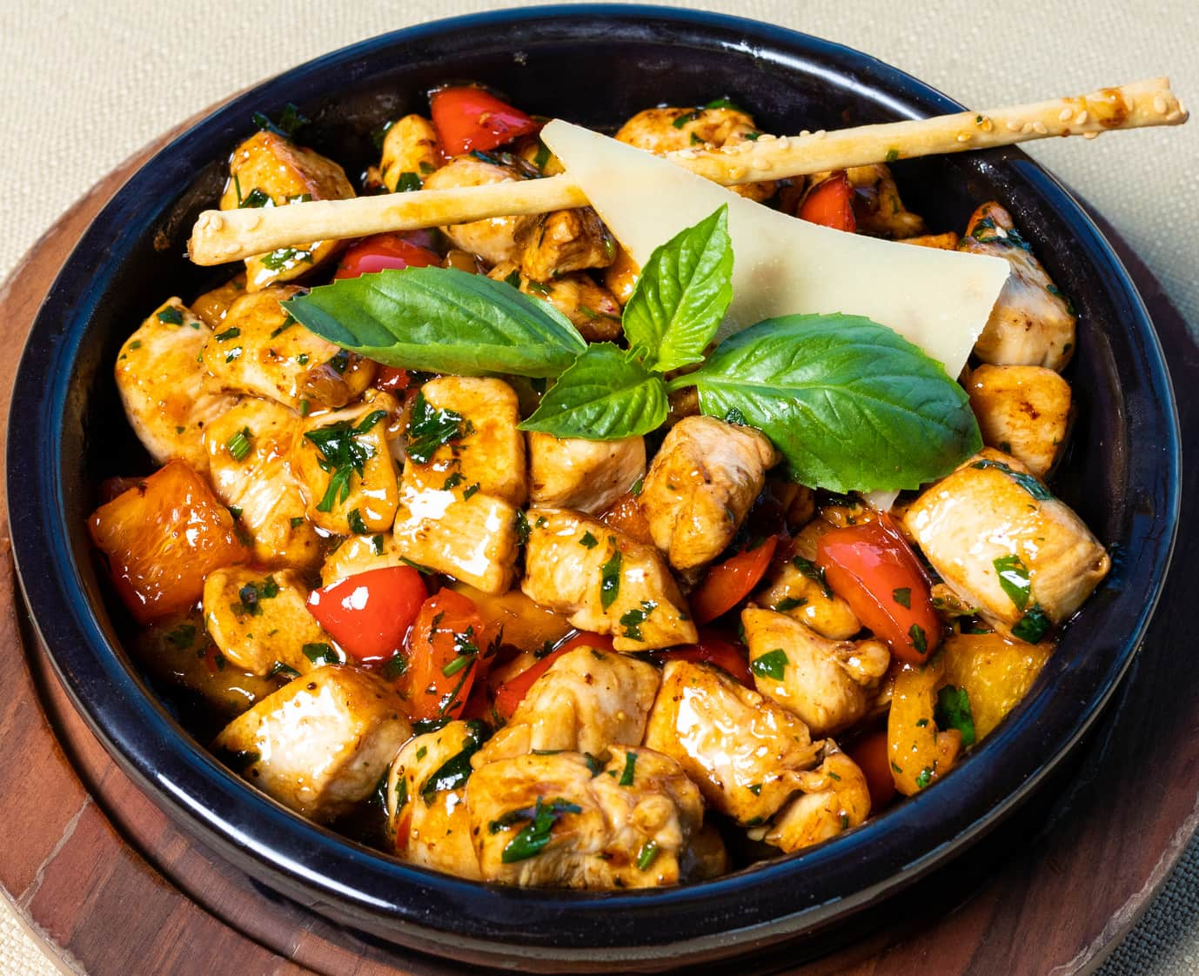
Grand restaurant
Features Of
Grand Restaurant
01
User-friendly interface
02
Secure payment options
03
Real-time tracking
Offers, Discounts &
Loyalty Programs
04

Slide 7

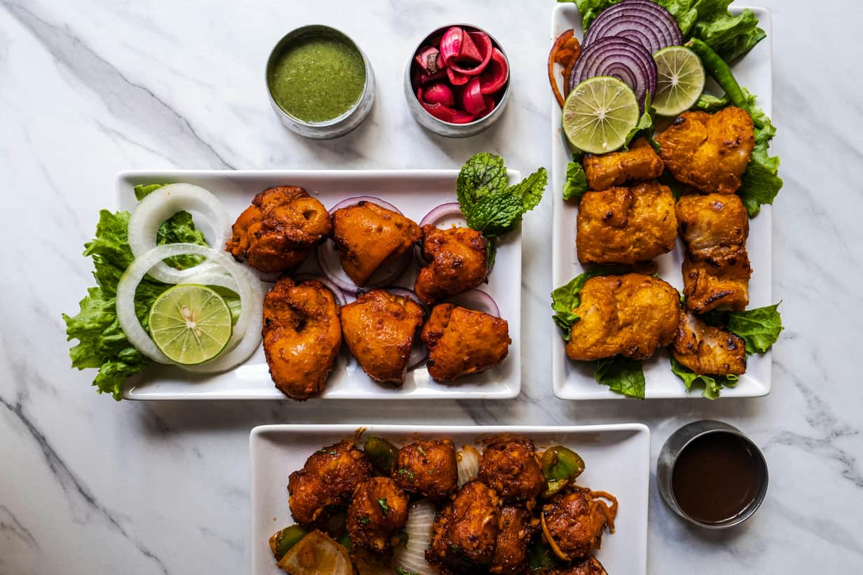



Grand restaurant
Goal Of Classic Cravings
Provide a Convenient Food
Ordering Experience
Ensure Food Safety and
Quality
Support a Wide Range of
Cuisines and Dietary Preferences
Sustainability and Cost-
Effectiveness

Slide 8
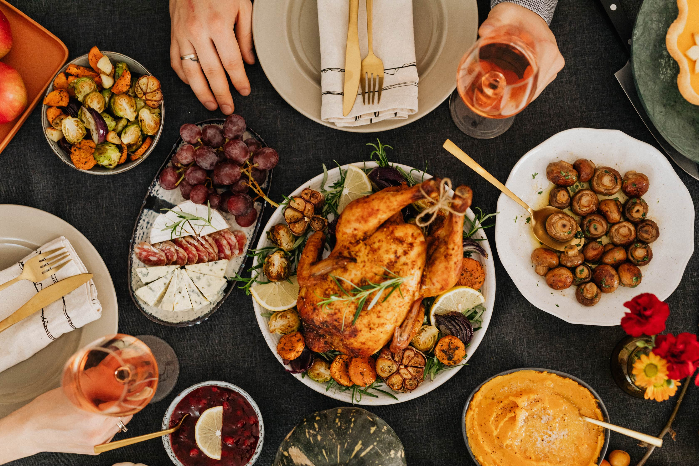
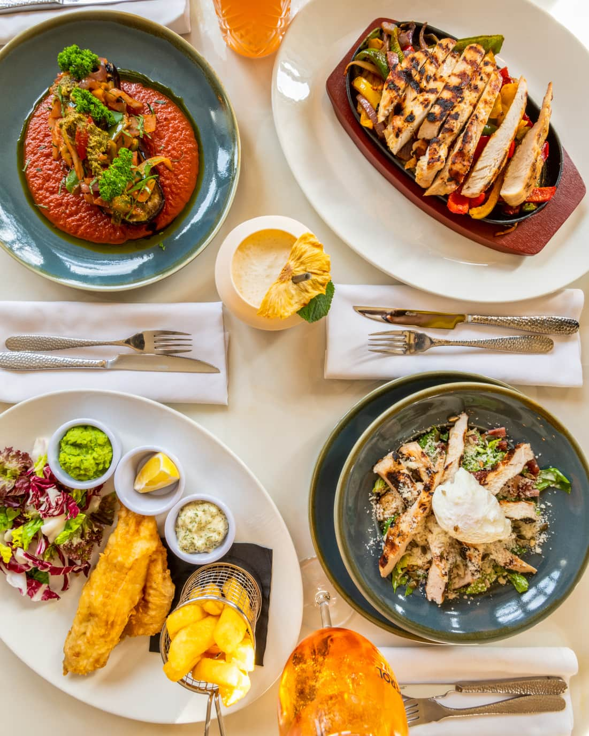
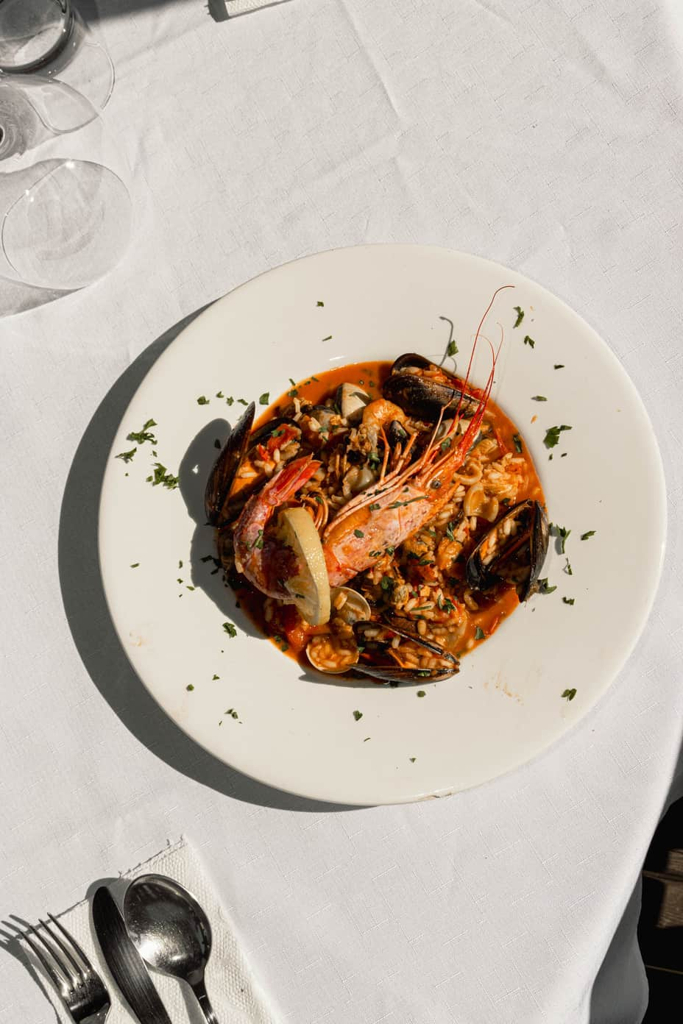
Grand restaurant
Flow chart :-

Slide 9
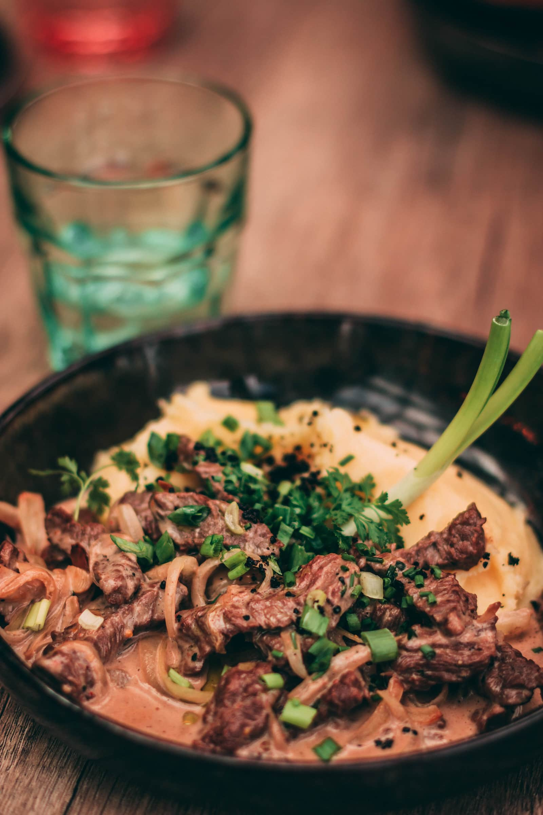
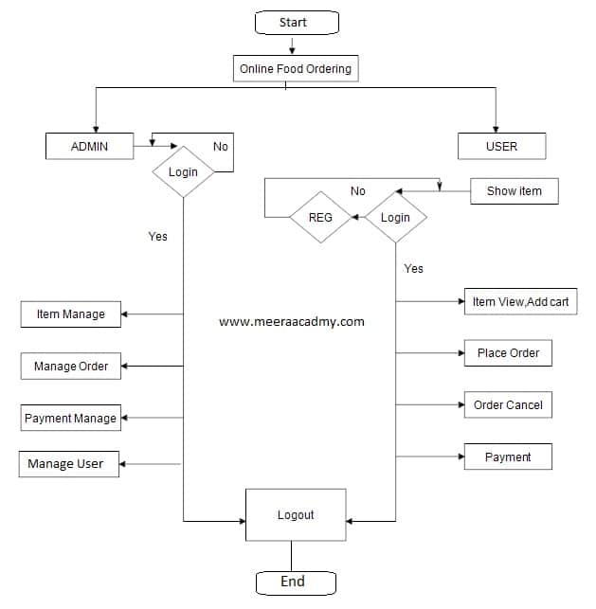


Slide 10

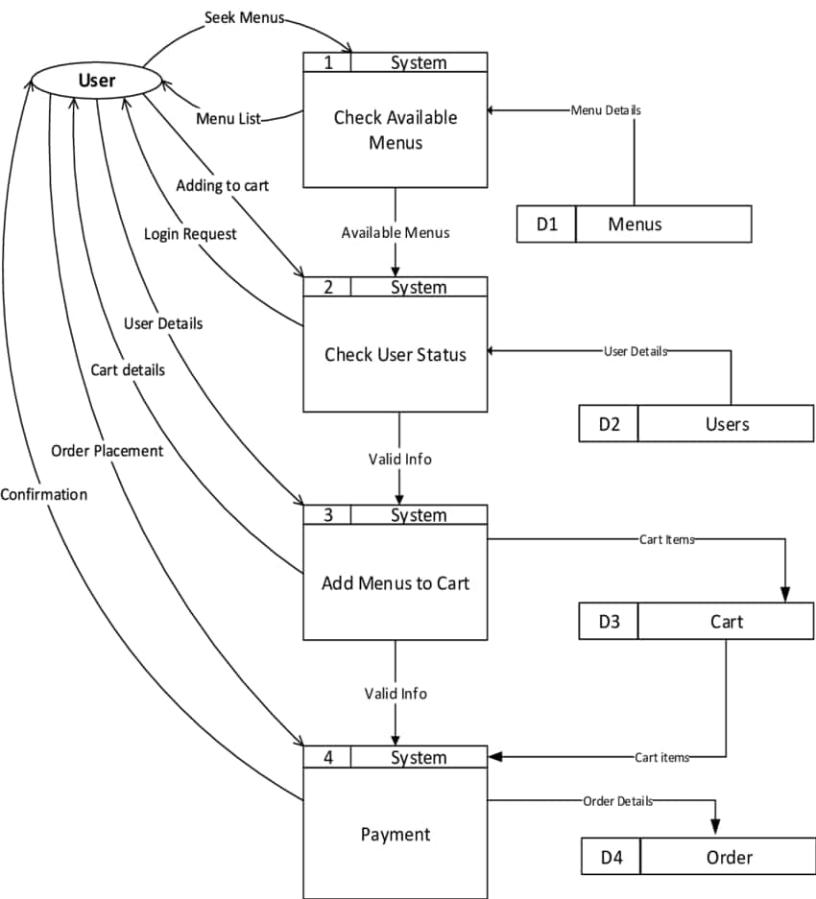
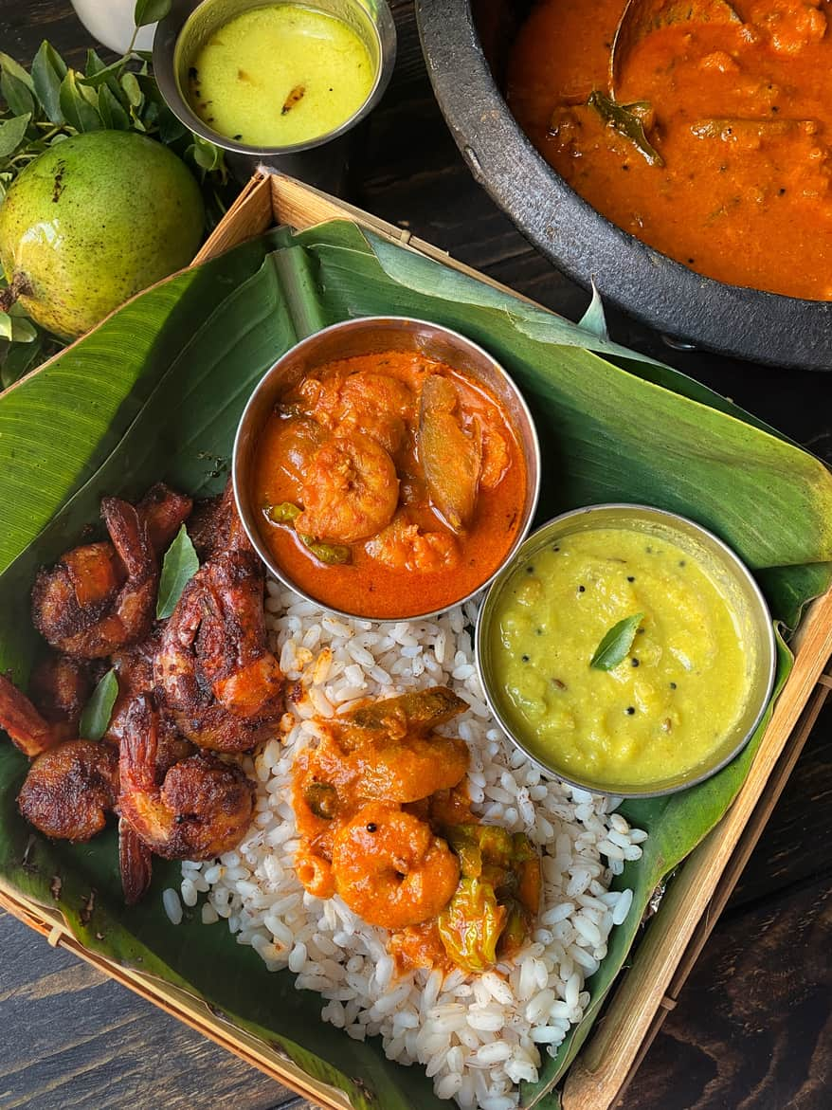
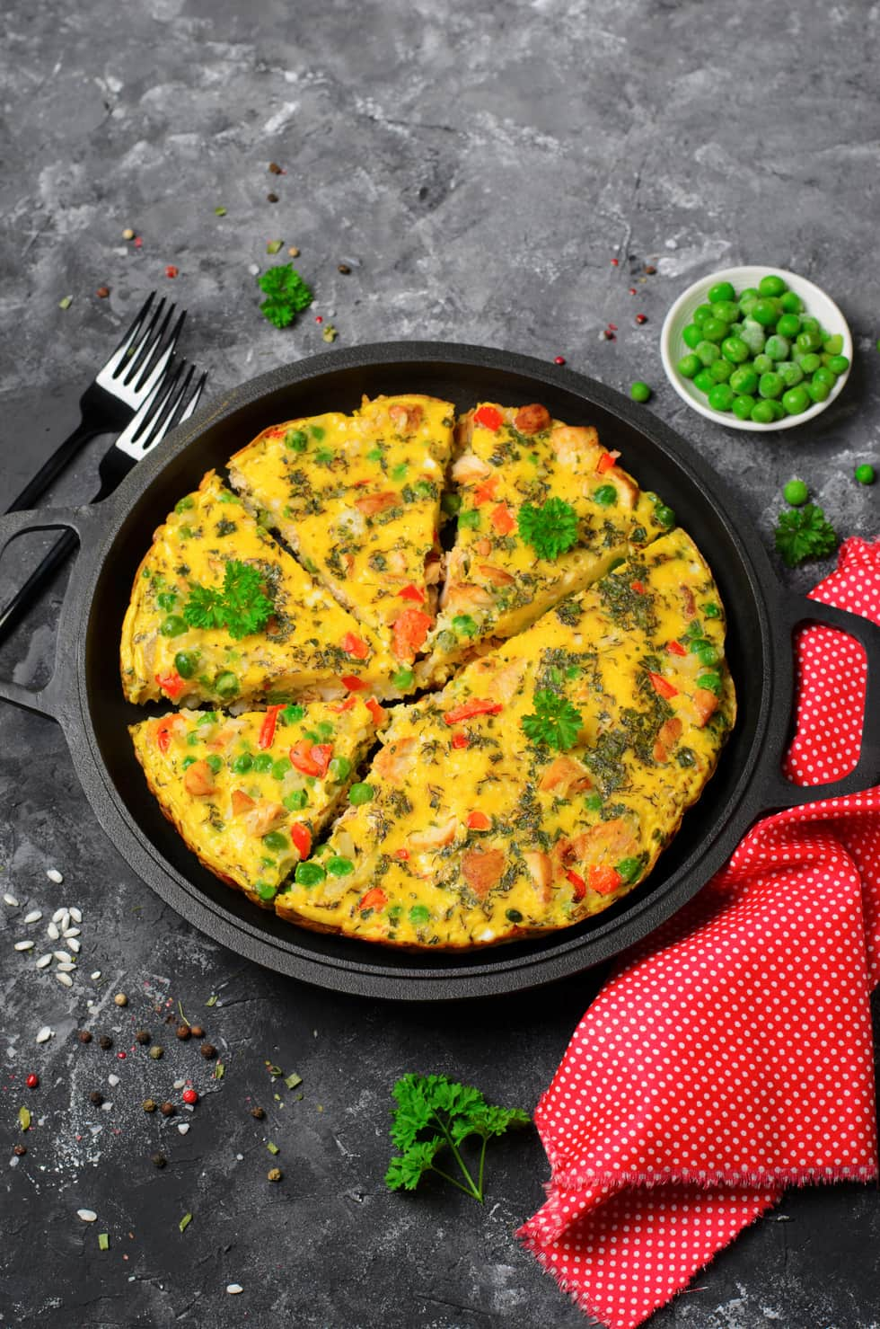
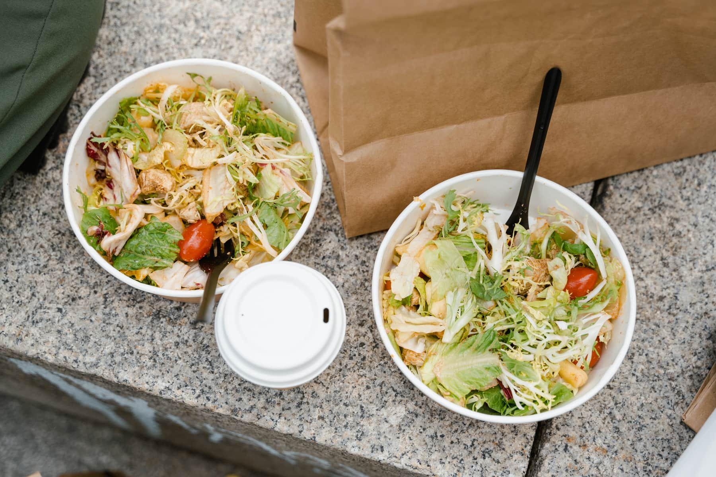

Slide 11
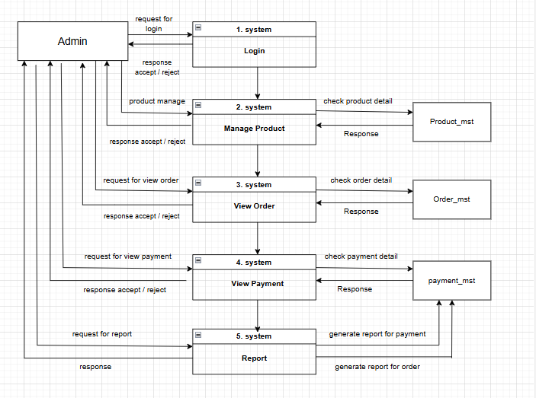
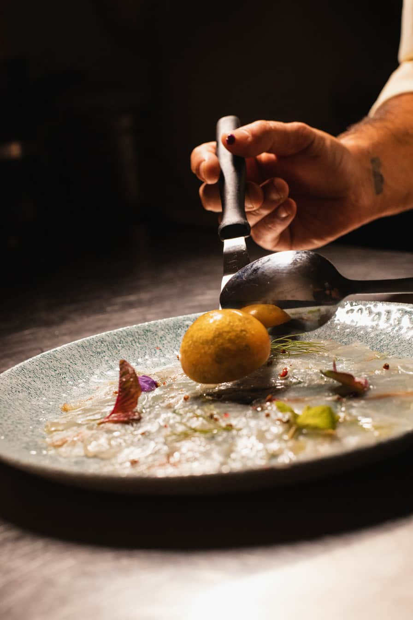
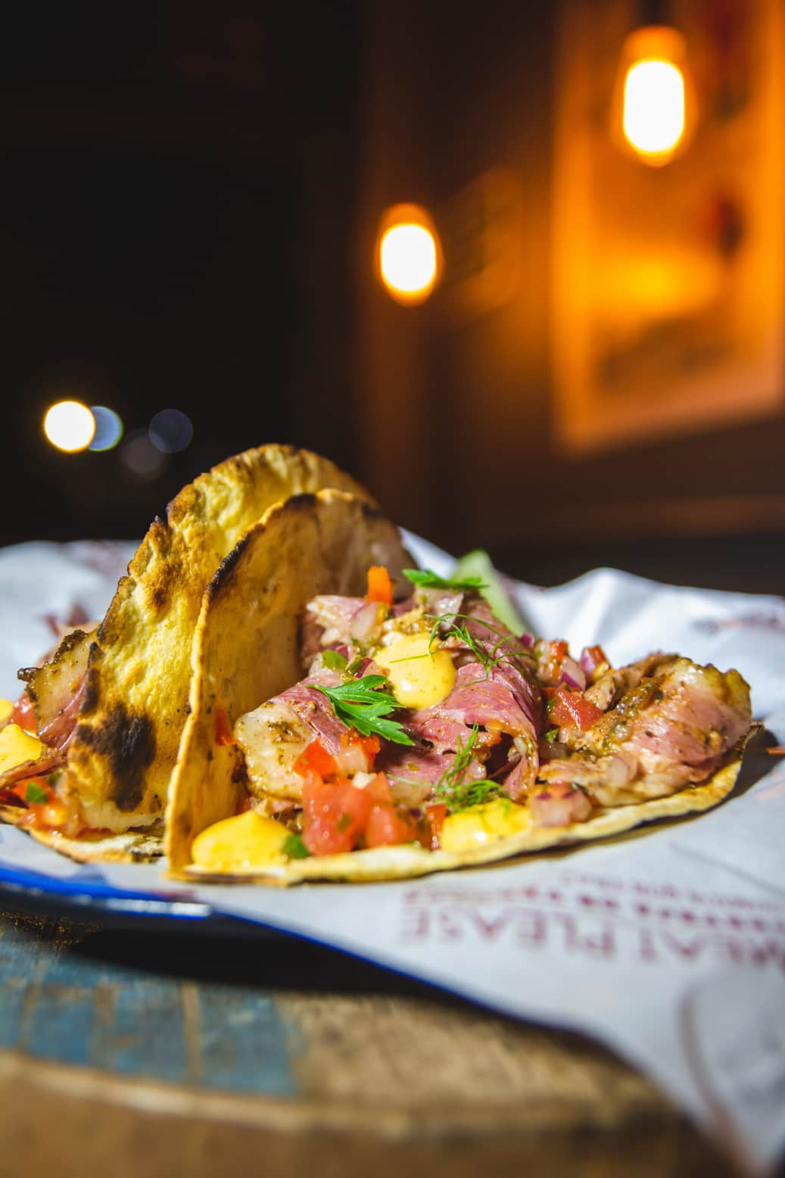
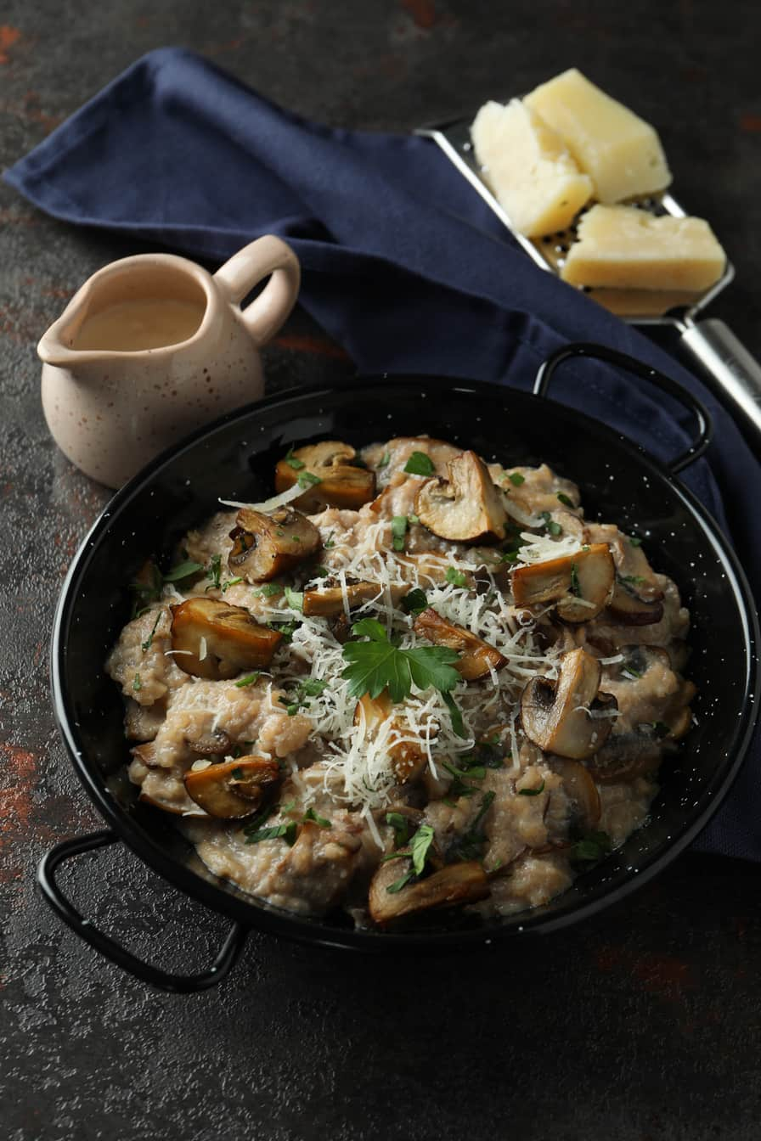

Slide 12
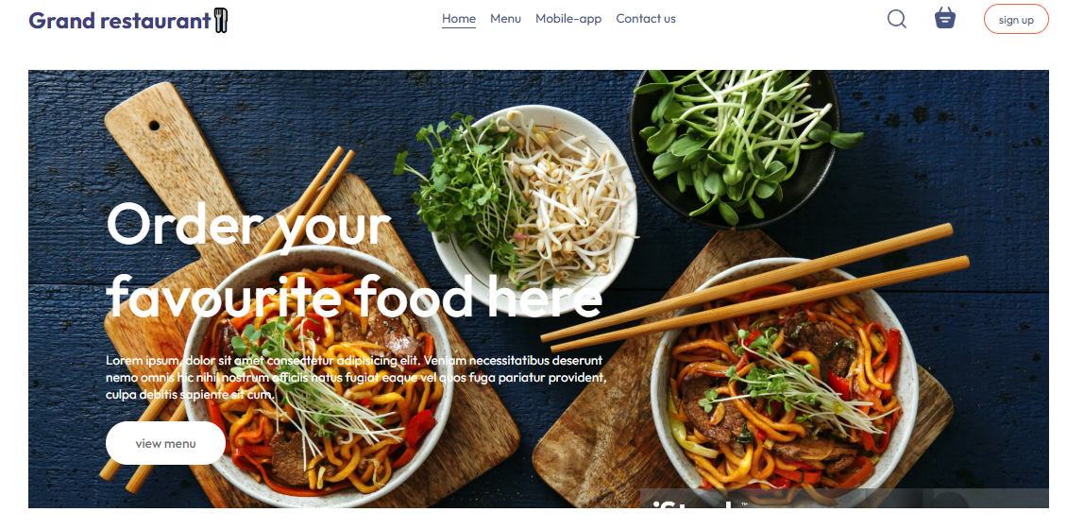
Website Design :-

Slide 13
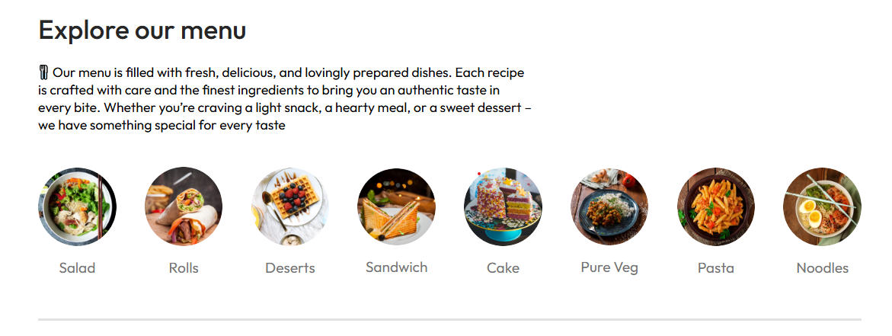
Menu Bar :-

Slide 14
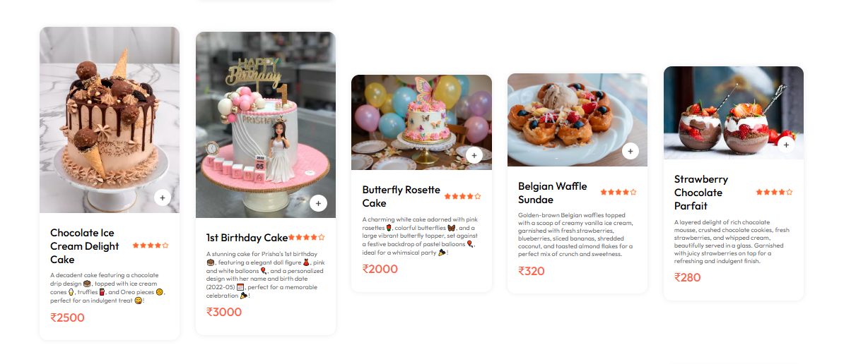
Menu :-

Slide 15
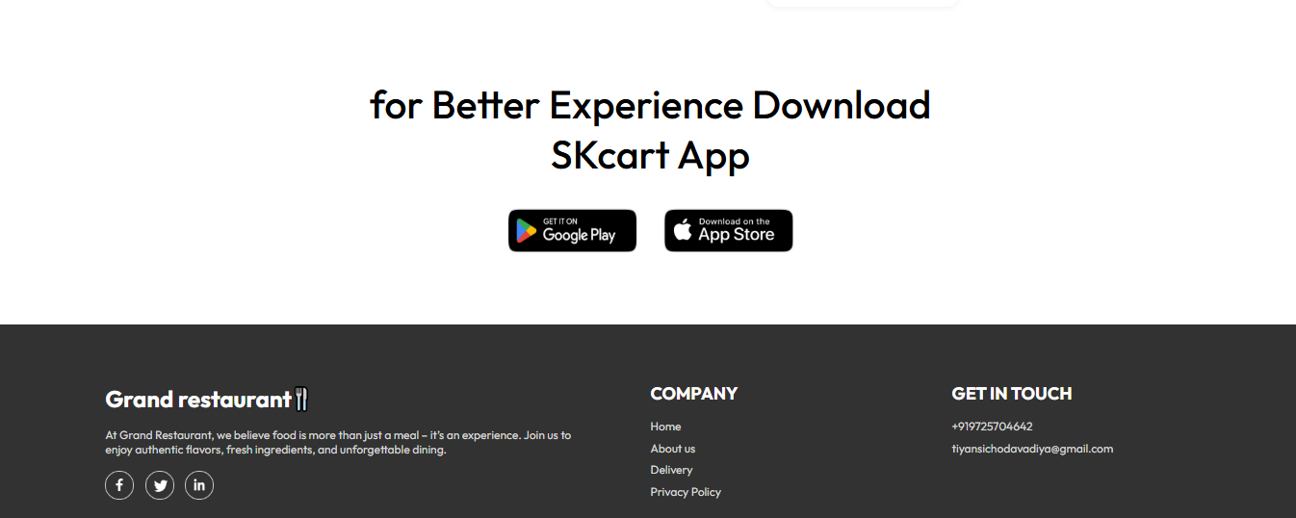
Footer :-

Slide 16
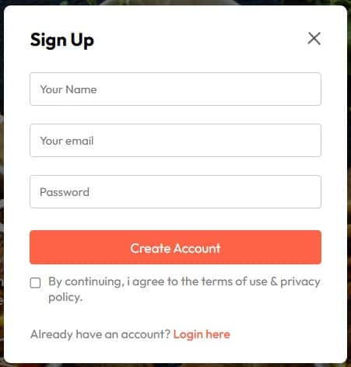
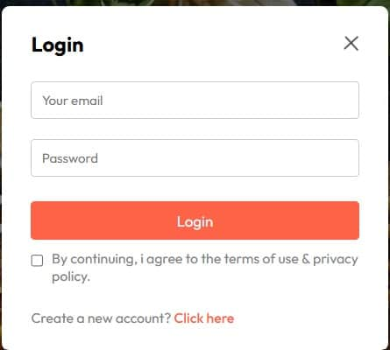
Sign up & Login :-

Slide 17
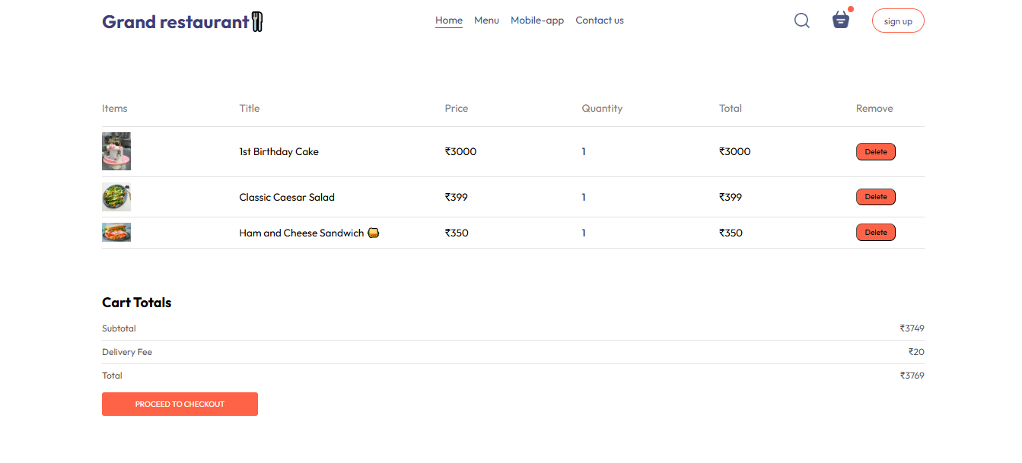
Website Design :-

Slide 18
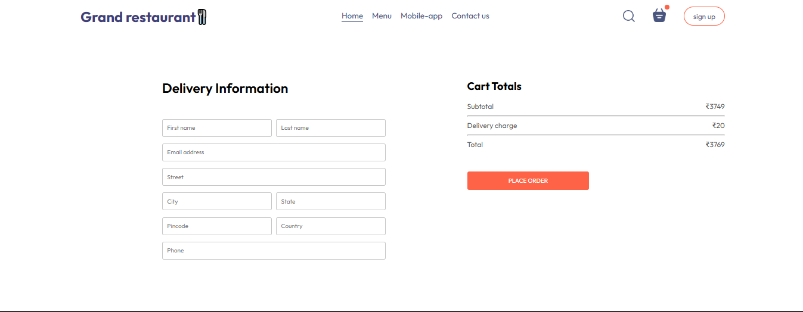
Address :-

Slide 19
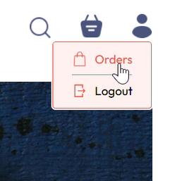
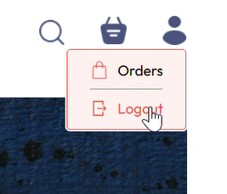
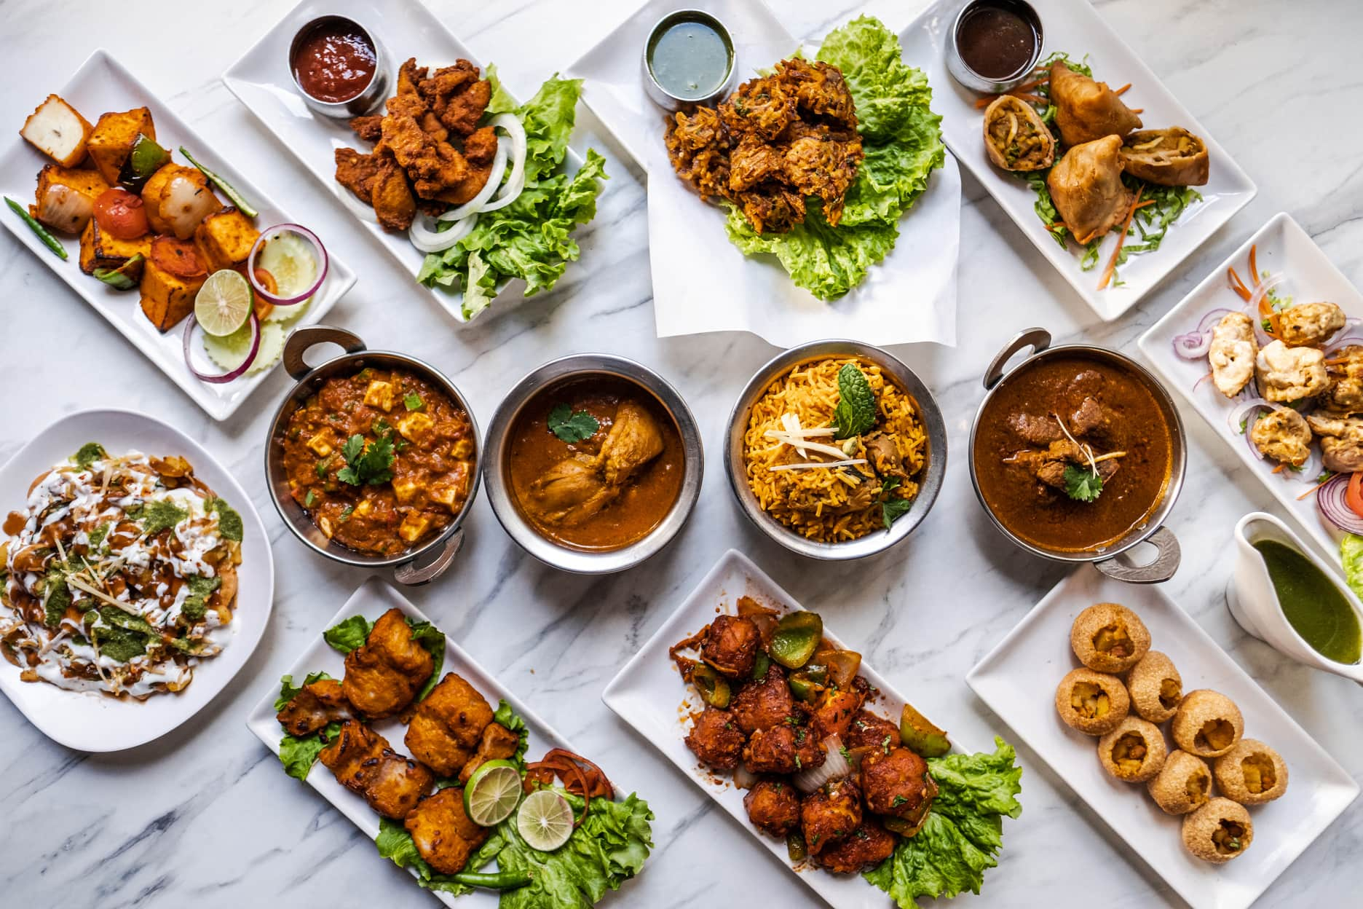
Cart :-

Slide 20
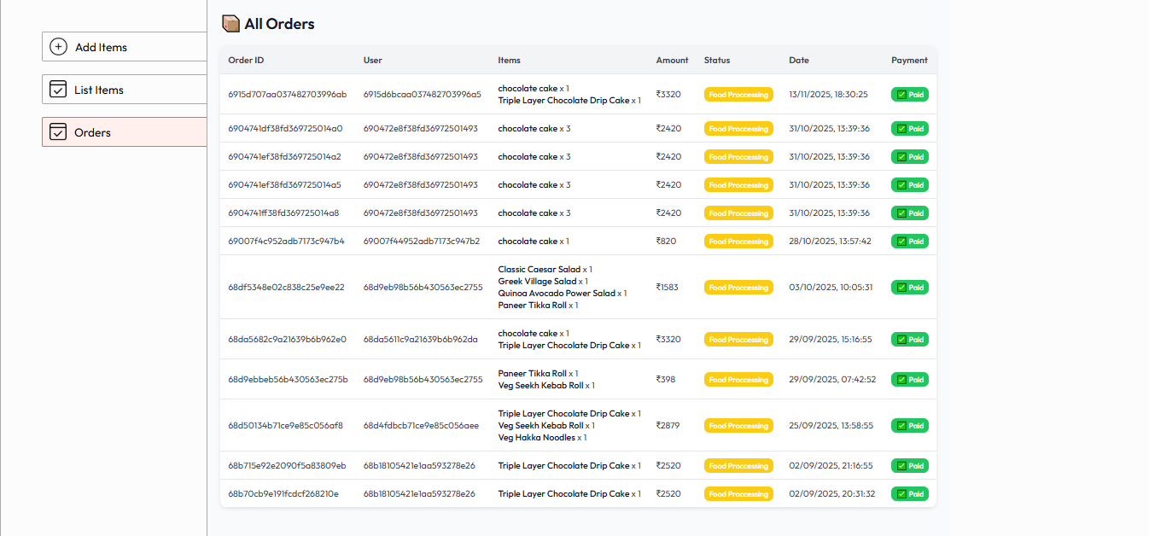
Orders :-

Slide 21
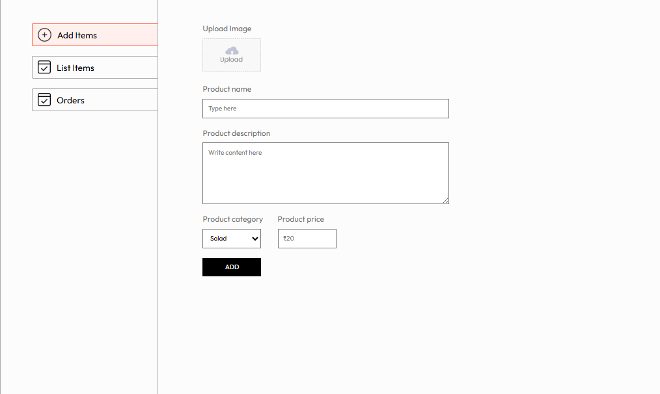
Admin panel :-

Slide 22
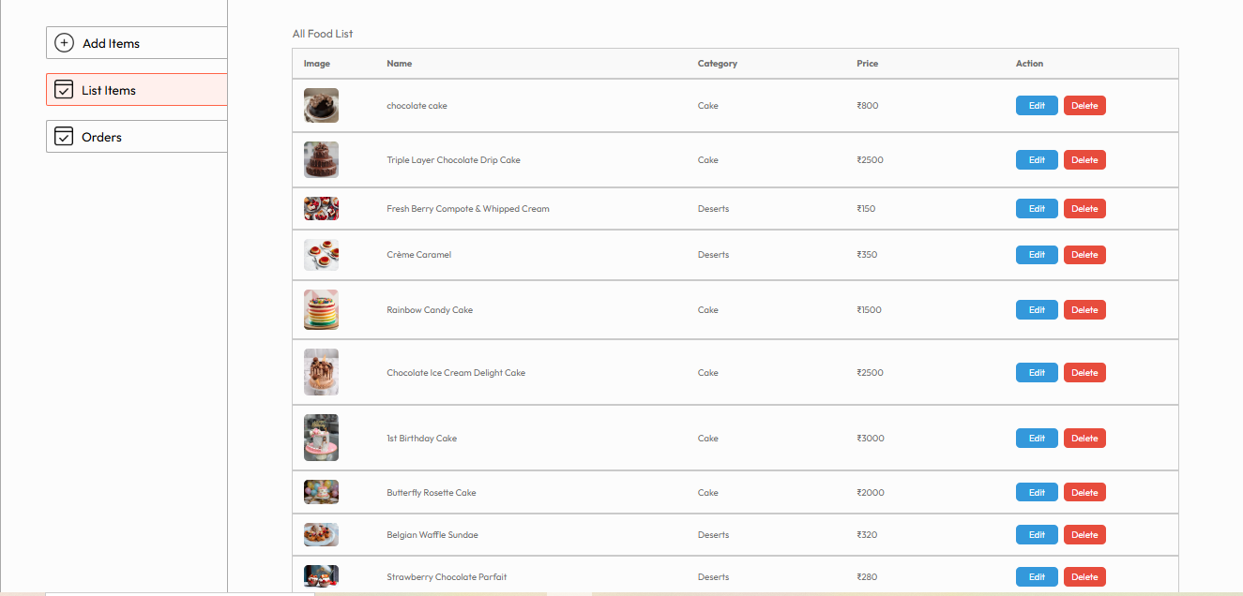
Website Design :-

Slide 23
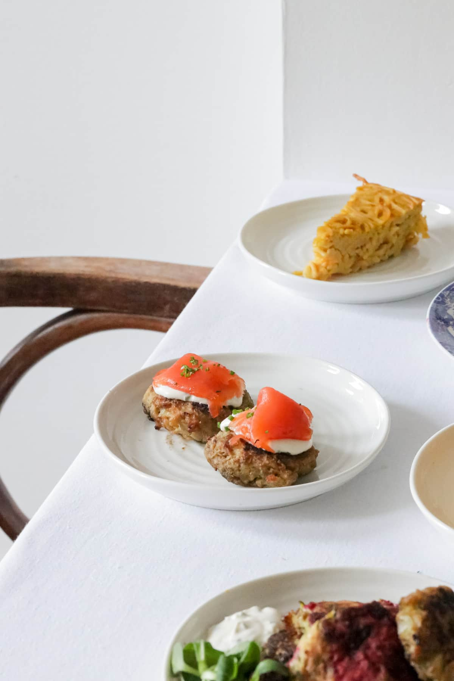
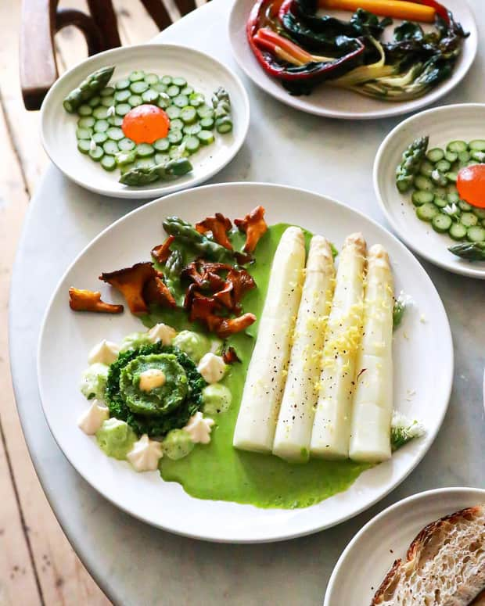
Grand restaurant
Visit Information Contact Us
Phone
Email
+919725704642
tiyansichodavadiya@gmail.com
Website
Address
www.grandrestaurant.com
544, RJD Complex , surat

Slide 24

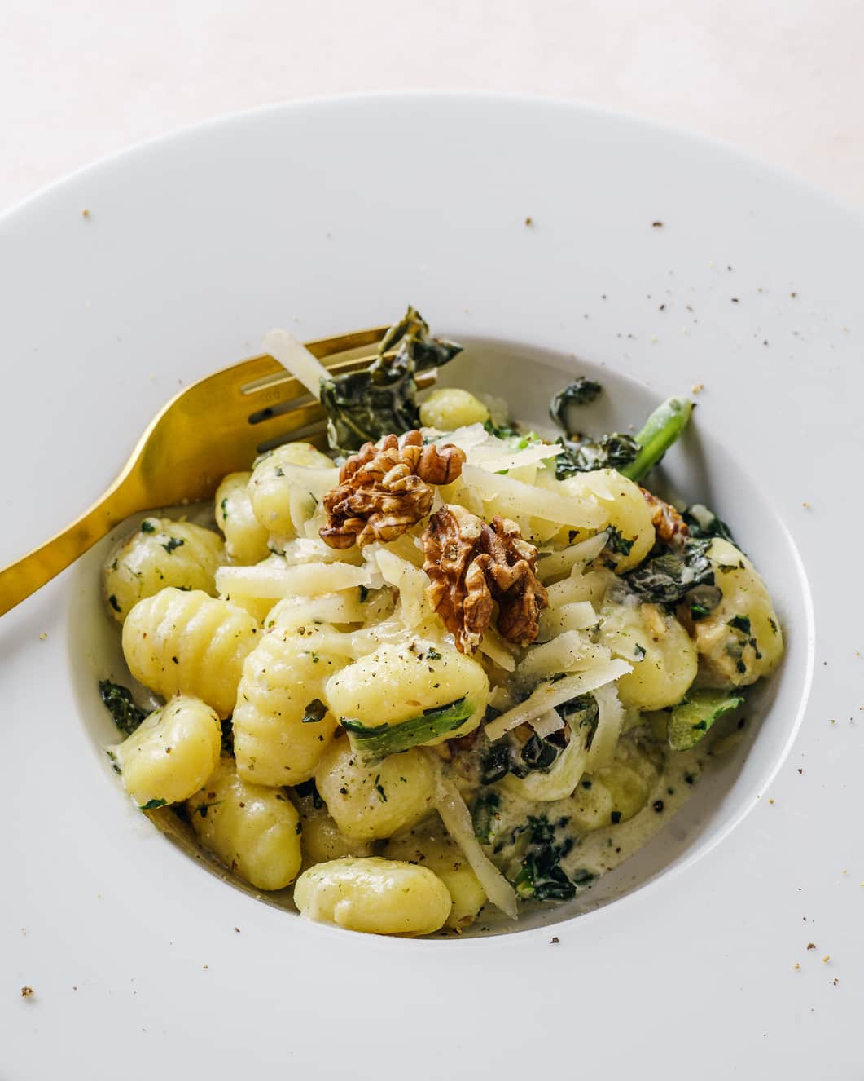
Thank You For Your Attention

